Slide 1

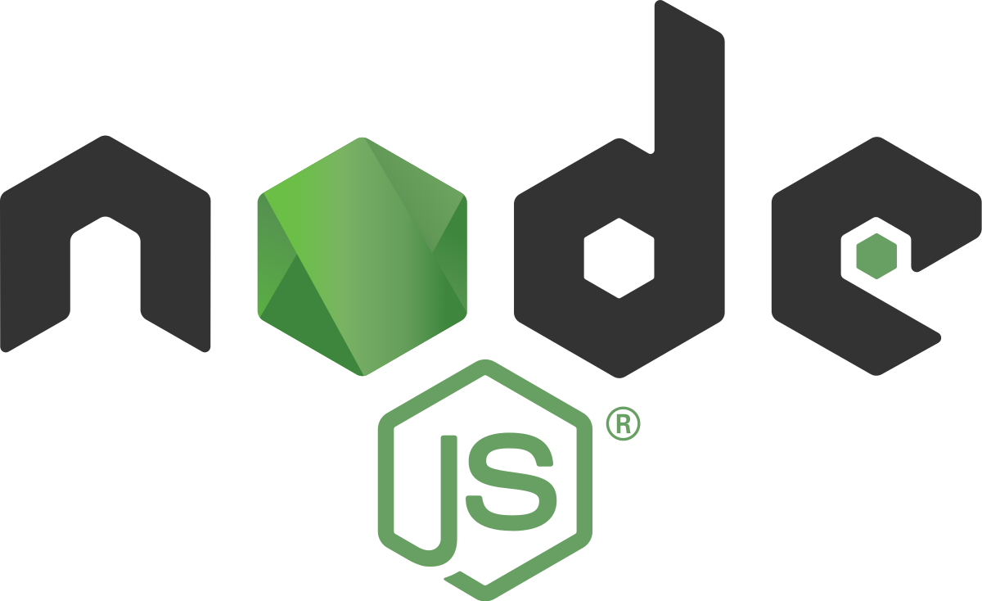
is a free, open-source, cross-platform JavaScript runtime environment
Gilad Meirson

Slide 2
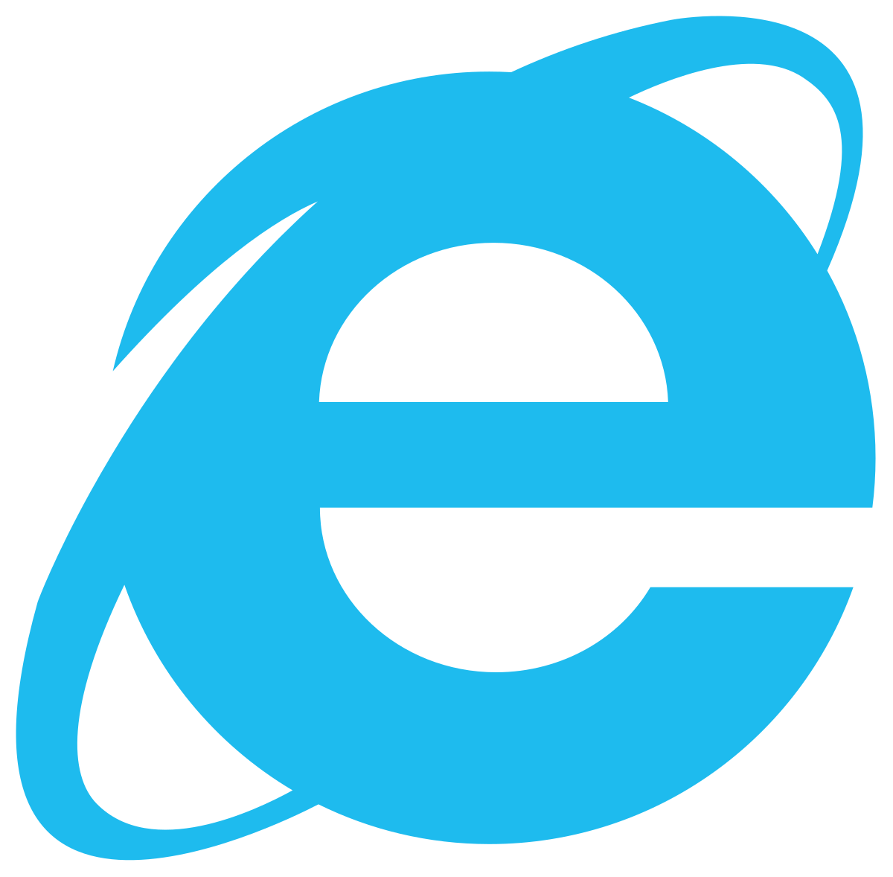

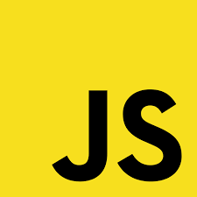







JS היסטוריה של
AUG - 1996
Microsoft launches Internet Explorer
DEC - 1995
Live-Script
become
Java-Script
JUN - 1997
The first standardization ECMA script
1995
First version of
Java-script
SEP - 1995
Mocha become
Live-Script
OCT – 1994
Netscape Navigator
1999
ES3
2003
Created JSON
Reverse engineering js to Jscript
The first standardization ECMA script
more operators
Marc Andreessen
Brendon Eich
Douglas Crockford

Slide 3






JS היסטוריה של
2009
Server-side runtime development environment
2008
Released of Chrome and V8
JUN-2015
Released of ES6
2006
Jquery released
DEC-2009
Released of ES5
OCT-2010
Angular
2015
React.js
The first big library
A lot more operators
Ryan Dahl

Slide 4

Any application that can be written in JavaScript, will eventually be written in JavaScript.
-- Jeff Atwood, 2009
Founder of Stack Exchange

Slide 5




Built twice as fast with fewer people
33% fewer lines of code
40% fewer files
2X request / sec
35% faster response time
Fast and highly scalable
33% fewer lines of code
Java script everywhere
Cleaner and more consistent codebase
Largest ecosystem of open-source libs

Slide 6
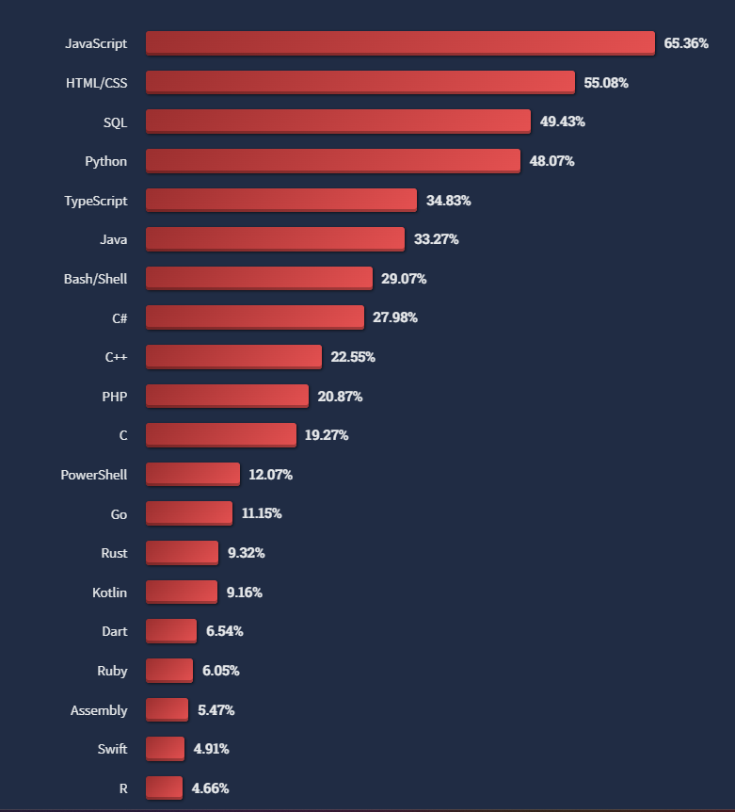
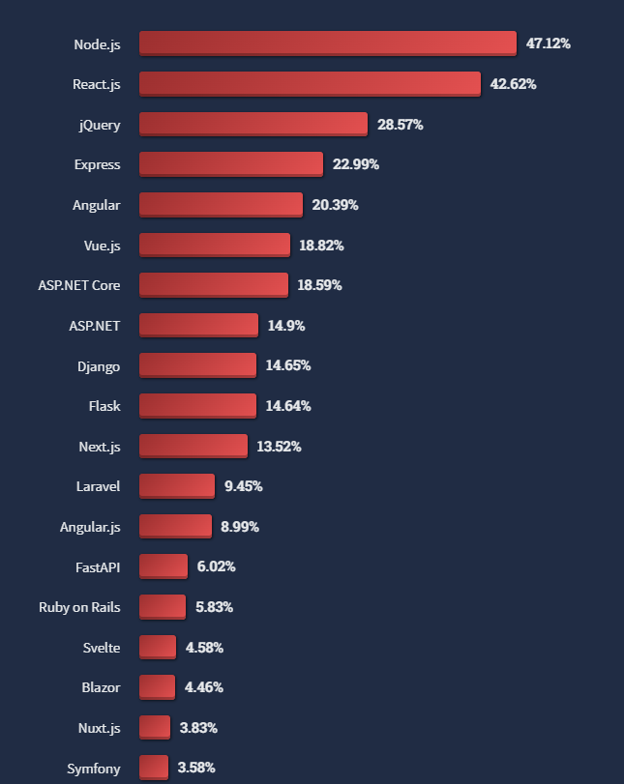
survey.stackoverflow.co
Programming, scripting, and markup languages
Web frameworks and technologies

Slide 7
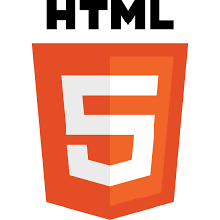
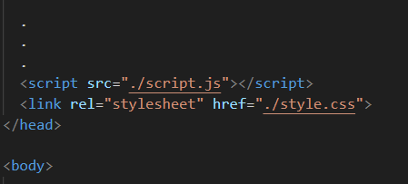
So how did we run JS until now?
And Now ?
Install node from https://nodejs.org/en
Create js file
Open the terminal and run the “node” or “node –v” to check the version of the Node.js
Write some consol.log(“hello world”) in the js file and execute the file with “node filename.js”

Slide 8
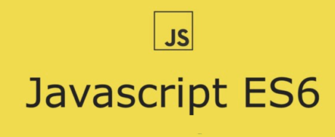
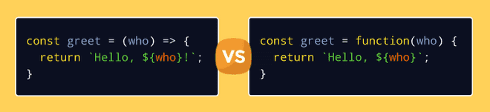
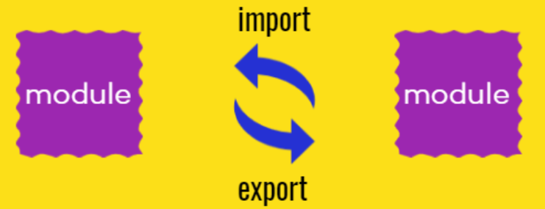
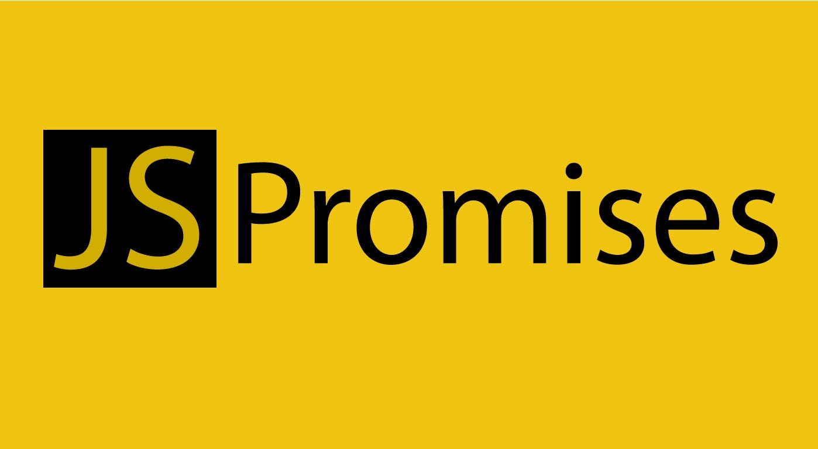
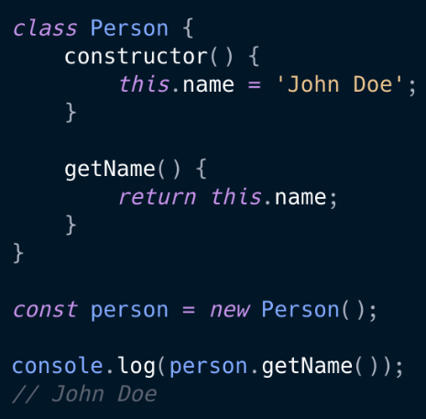
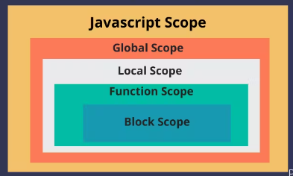
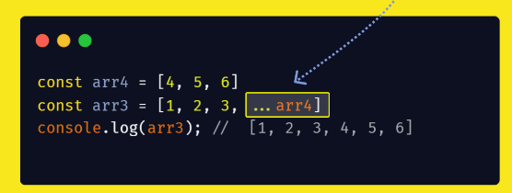
Functions
Import & Export
Classes
Block-Scoped Variables
Spread Operator

Slide 9
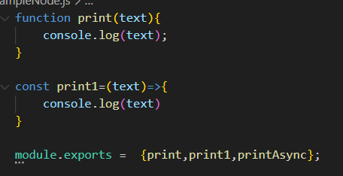
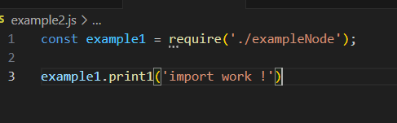
class exercise - import & export

Slide 10
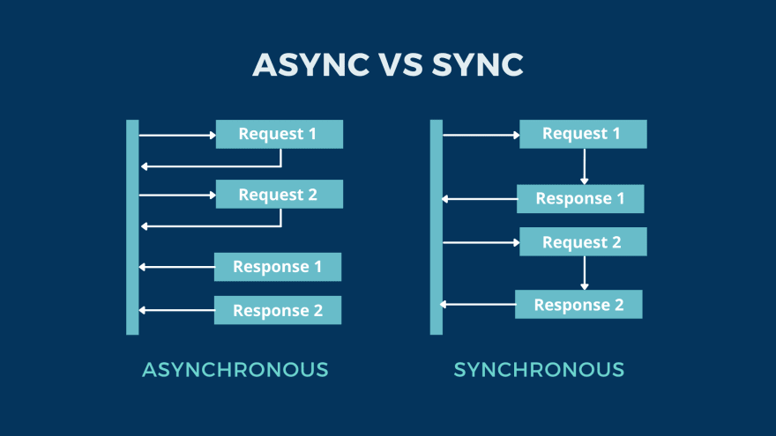
Promise & Async code
The async problem : link

Slide 11
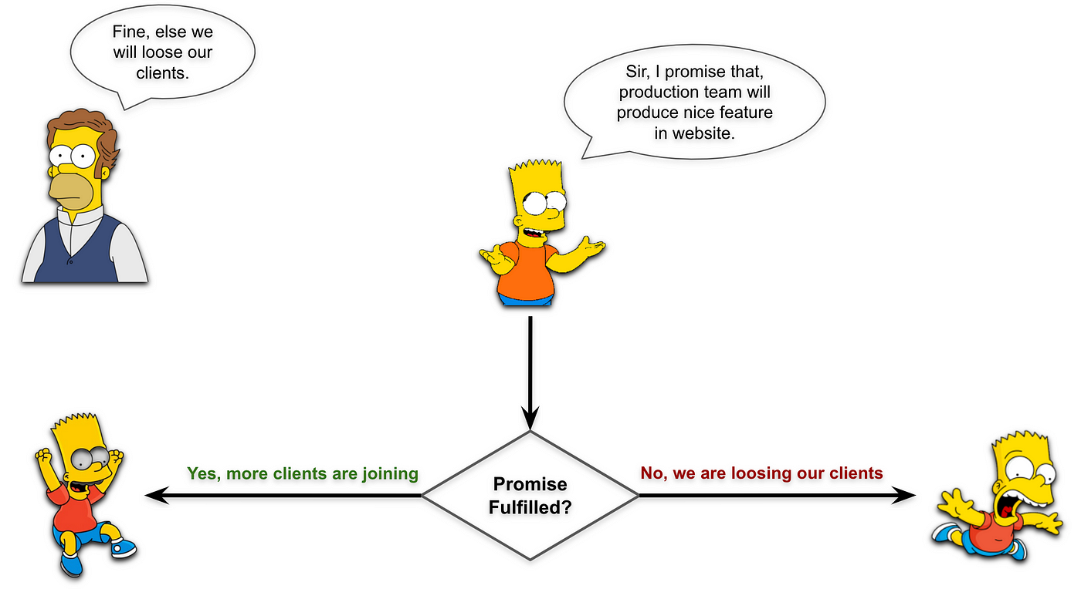
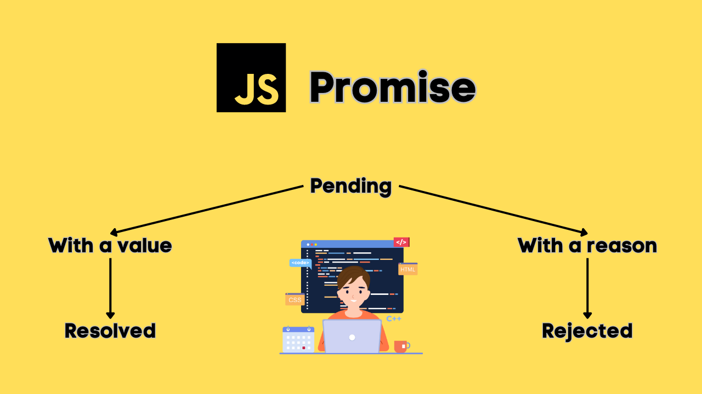
Promise & Async code
Solution using await or promise: link

Slide 12
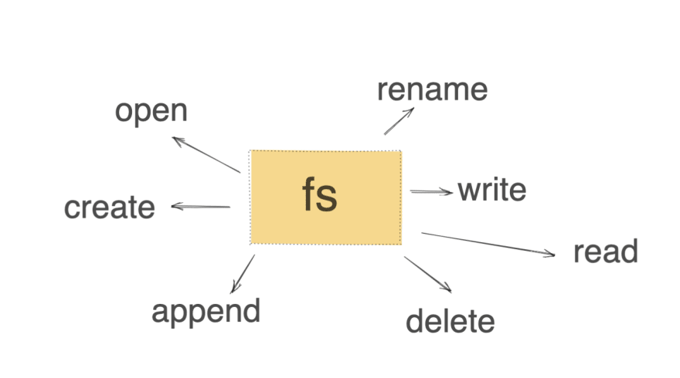
File System js
example: link

Slide 13
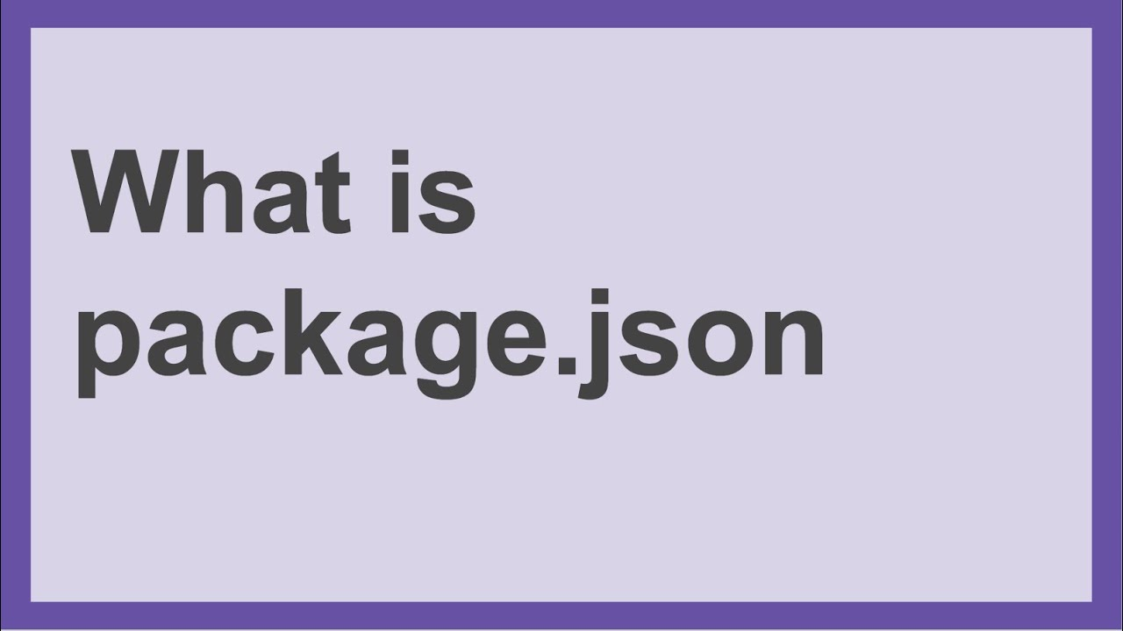
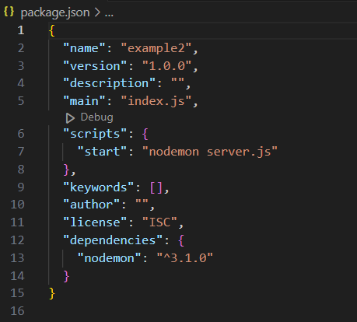
The package.json file in a Node.js project serves as a central repository for configuration of tools, scripts, and metadata related to the project. It includes:
Metadata about the project: Such as the project's name, version, description, author, and license.
List of dependencies: Specifies the packages the project depends on to run. These can be divided into dependencies for runtime packages and devDependencies for development-time packages.
Scripts: Custom scripts that can be run with npm run <script-name>. Common scripts include start, test, and build.
Version constraints for Node.js: Specifies which versions of Node.js the project is compatible with.
Other configurations: For various tools and libraries (like Babel, ESLint, etc.) integrated into the project.

Slide 14

NPM is a package manager for JavaScript, used to install, share, and manage library dependencies in projects. It interacts with a registry of over 800,000 packages, facilitating code reuse and efficient project management.
https://www.npmjs.com/
Top NPM rank

Slide 15
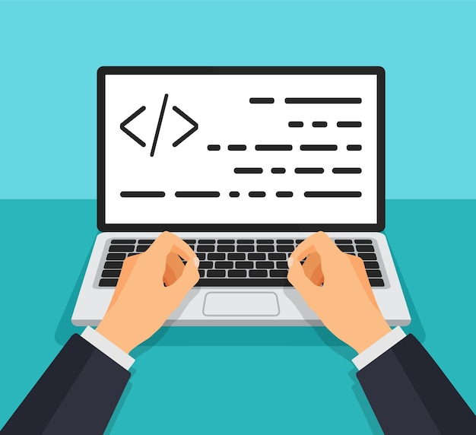
Lets create a server !
Open vs code and write npm init –y to generate the package.json file.
Create new js file and require the http module.
Create server using http module
Use res.writeHead and res.end functions to return response.
Change in the package.json in scripts:start:”node your File Name”.
Run with npm start
Test the api with the Postman tool
the course notebook

Slide 16
GET & POST in Node.js
Install nodemon into your project and update the package.json in the scripts: start: nodemon “your file name”.
Add an if statement to control POST and GET requests.
Add an if statement to control the url routing
Handle the GET and POST methods and return some JSON.
the course notebook

Slide 17
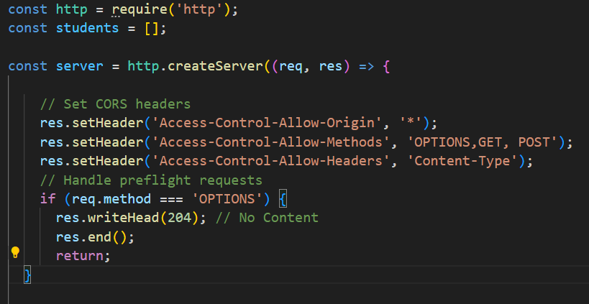
GET & POST in Node.js & Client
Continue with the previous exercise.
You will create an HTML client page and a JS script that receives an ID and name from the user and makes a fetch\ajax to the server.
At the beginning of the server program, add a global array of Students
Add the following code to handle the CORS issue.
The GET and POST methods handle adding a student to the array and returning the array.
the course notebook

Slide 18
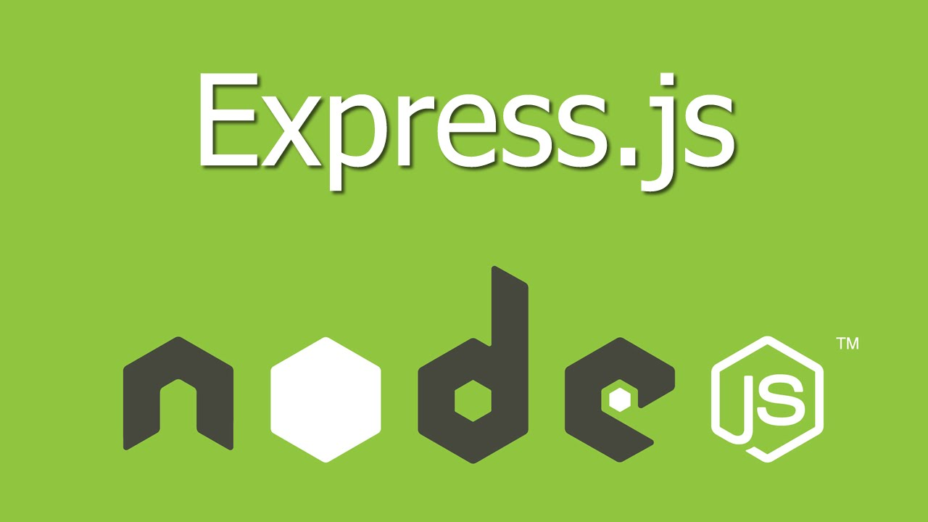
Express is a minimal and flexible Node.js web application framework that provides a robust set of features for web and mobile applications.

Slide 19
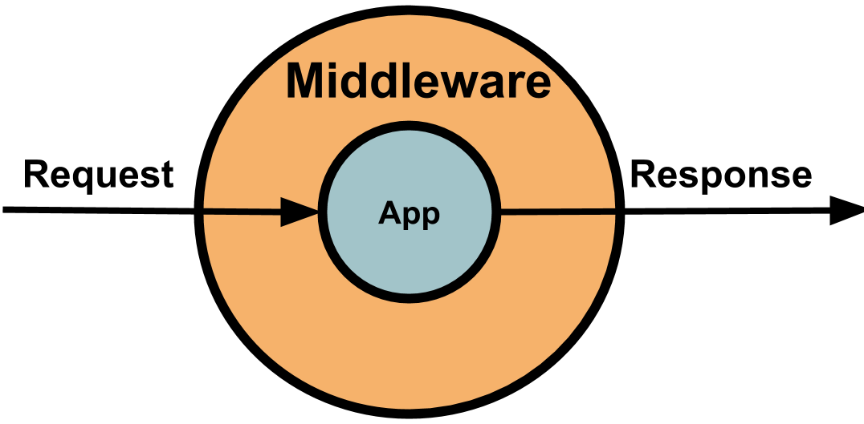
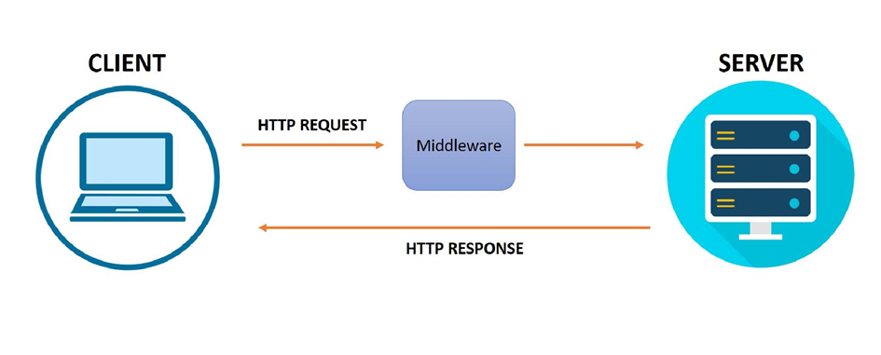
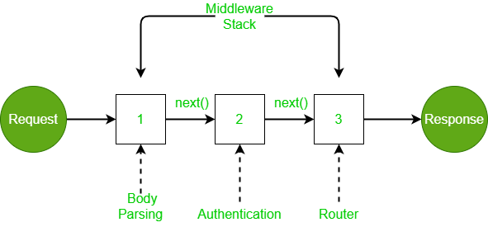
What is Middleware ?
Middleware is a function that processes requests and responses in your application. It can execute code, modify request and response objects,
end the cycle, or call the next middleware.
Examples include parsing request bodies, logging, authentication, and more. Middleware allows for modular and reusable code to manage request processing efficiently.

Slide 20
Lets create server with express.js
Install nodemon into your project and update the package.json in the scripts: start: nodemon “your file name”.
Install express.js
Use the express module to set the “app” variable.
Use Middleware to parse JSON data.
Write methods for GET and POST using app.get and app.post and return JSON or HTML.
Test the api with the Postman tool.
the course notebook

